Slide 1

ACCOUNTING RECREATIONAL CLUB

Slide 2

CONTENTS
01
Mission And Vision
02
Introduction to ARC
03
Yearly Event
04
Others

Slide 3
01
VISION AND MISSION
PART

Slide 4
VISION AND MISSION
Foster keen interest in studies
A platform for interactions between students and lecturer
Provide outside classroom learning
A platform for practical of management skill

Slide 5
02
INTRODUCTION TO ARC
PART

Slide 6
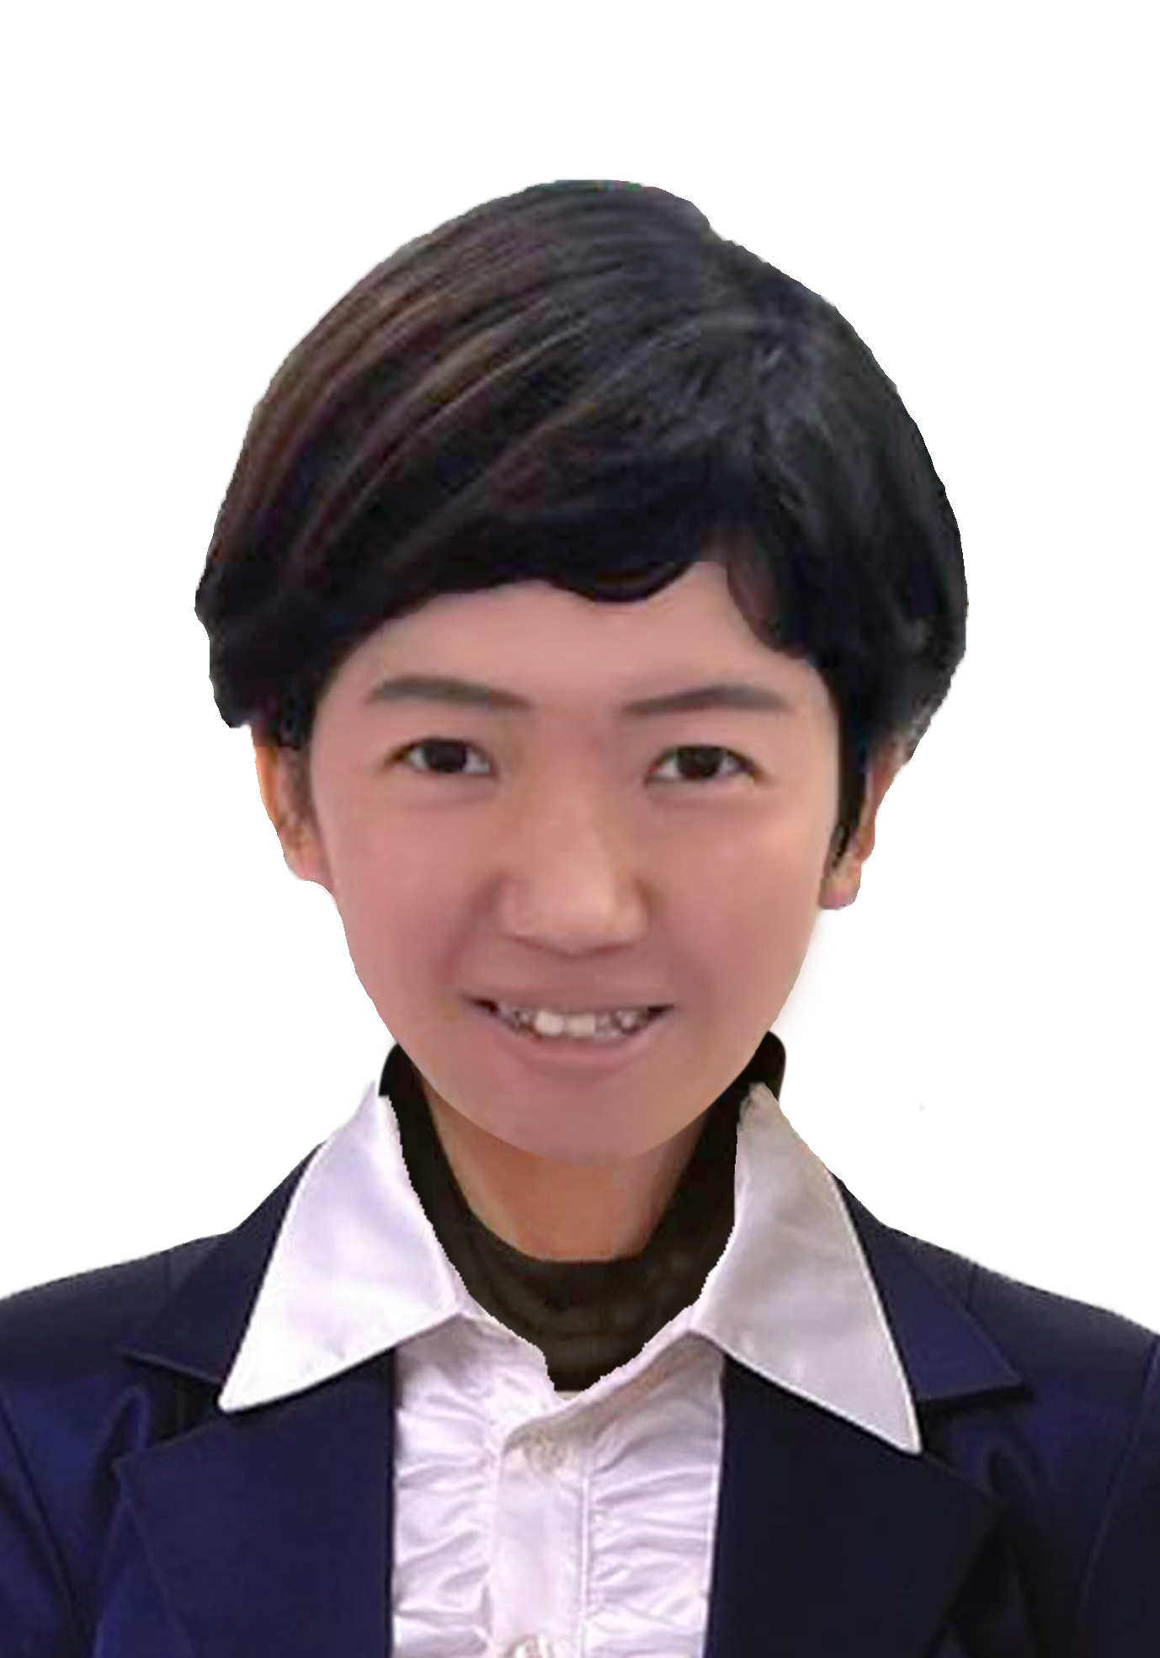
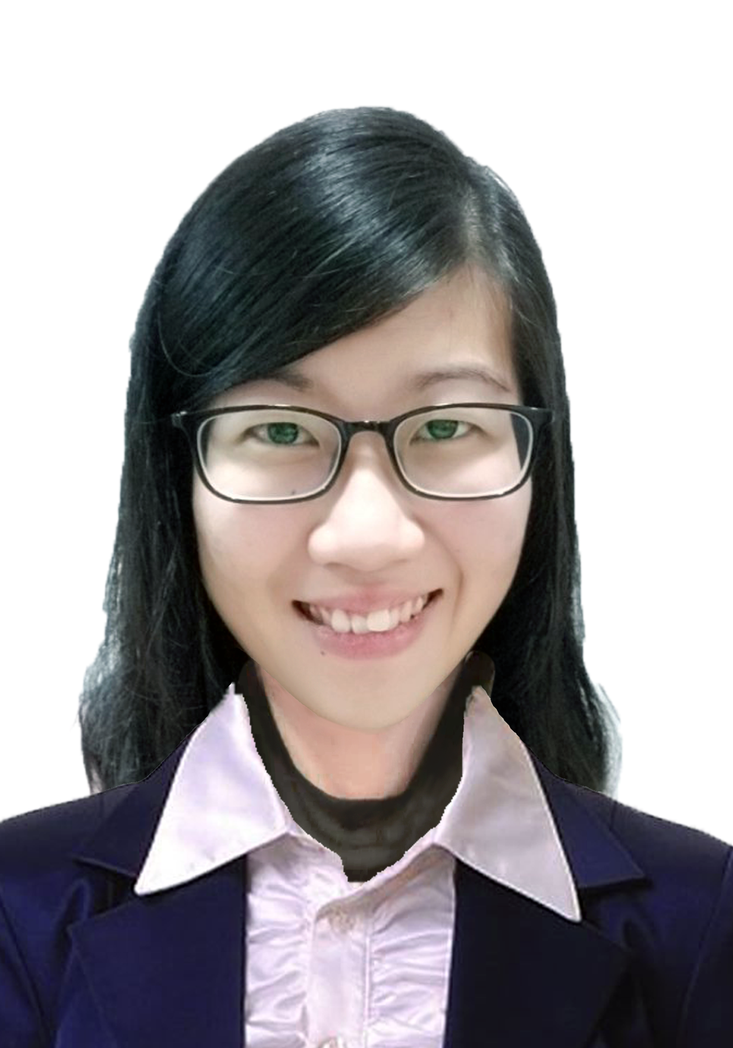
INTRODUCTION TO ARC
TIME
ADVISOR
1830 - 2100
Ms. Irene Choo
VENUE
Lecturer Hall 3 (LH3)
Ms. Angela Tiong

Slide 7
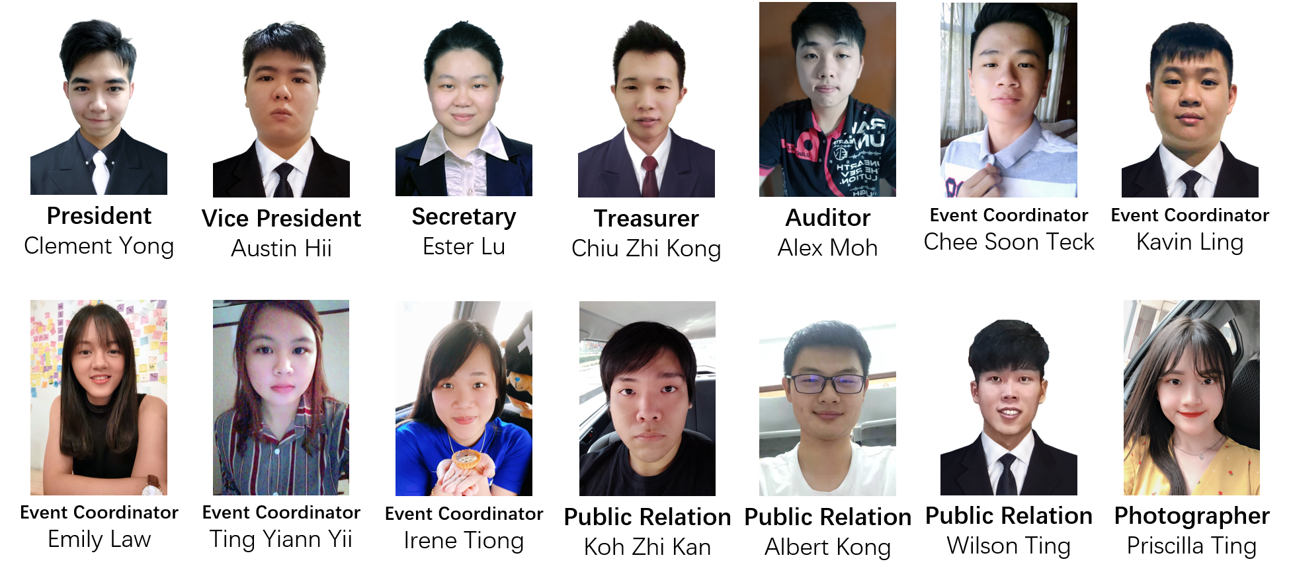
INTRODUCTION TO ARC
COMMITTEE 2020

Slide 8
03
YEARLY EVENT
PART

Slide 9
YEARLY EVENT
Event | Date | Target Number of People | Purpose
New Year Event | 20th January 2020 | 60 | Celebrate CNY
Mooncake Festival | - | 60 | Celebrate Mooncake Festival
Annual General Meeting | - | 50 | Voting and select committee member 2021

Slide 10
04
OTHERS
PART

Slide 11
OTHERS
Noticeboard Decoration
In progress. Public relations have responsibility on updating noticeboard.
Problem Faced
Make an attractive event
Lack of cash inflow/ donation/ sponsorship
Lack of relationship between Student Council
Hope
Event cooperate with other clubs and Student Council, E.g. Welcoming Party, Open Day.

Slide 12
THANK YOU

